Slide 1

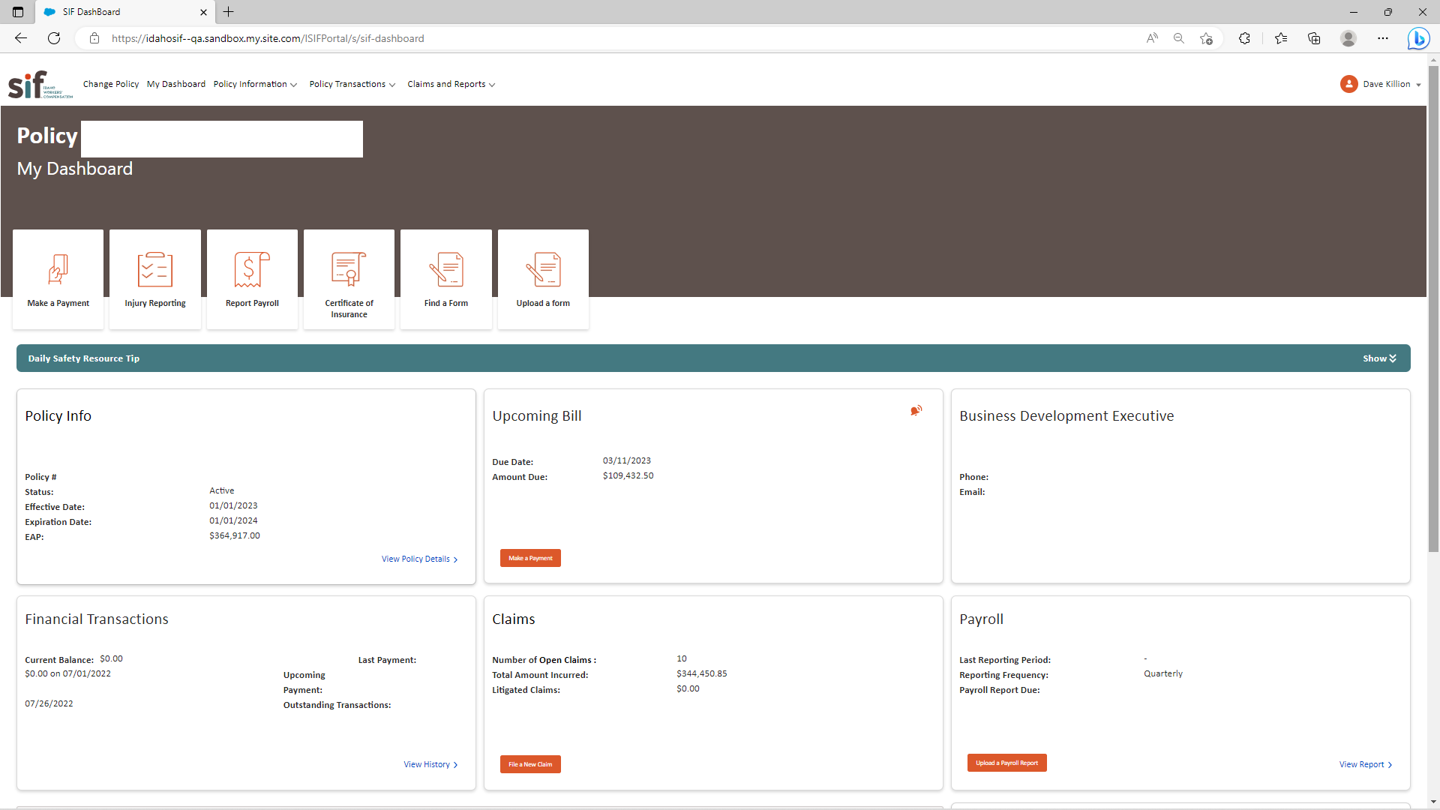
Idaho State Insurance Fund - Customer Portal
Business Need
Idaho State Insurance Fund is a workers’ compensation provider that was looking to modernize their customer portal with a unified login, personalized content, improved self-service capabilities, improved usability, and additional reporting tools.
Their current systems were spread across multiple platforms creating inconsistencies in data, slow manual processes, and very little automation.
What We Did
Affirma worked with the Idaho SIF team to redesign and migrate the portal to a new cloud technology framework, implementing a modernized approach to bill payments, policy management, and reporting.
The platform was also integrated with a third-party tool, Zywave, to provide users access to safety training and other online resources.
Users now have a much cleaner and more comprehensive user experience. Affirma continues to support Idaho SIF with ongoing enhancements and maintenance.

